Slide 1

Deep neural network training, tuning and prediction
Notes:
‹#›

Slide 2
Objectives
Understand the training, tuning, prediction a Deep Neural Network with Time Series Data
Implement Deep Neural Network with more layers
Deep neural network training, tuning and prediction
‹#›

Slide 3
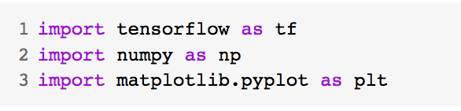
Training a Deep Neural Network
Imports libs
Tensorflow to build your model and prepare data windows
Numpy for numerical processing
Matplotlib's PyPlot library for visualization
Deep neural network training, tuning and prediction
‹#›
Notes:
‹#›

Slide 4
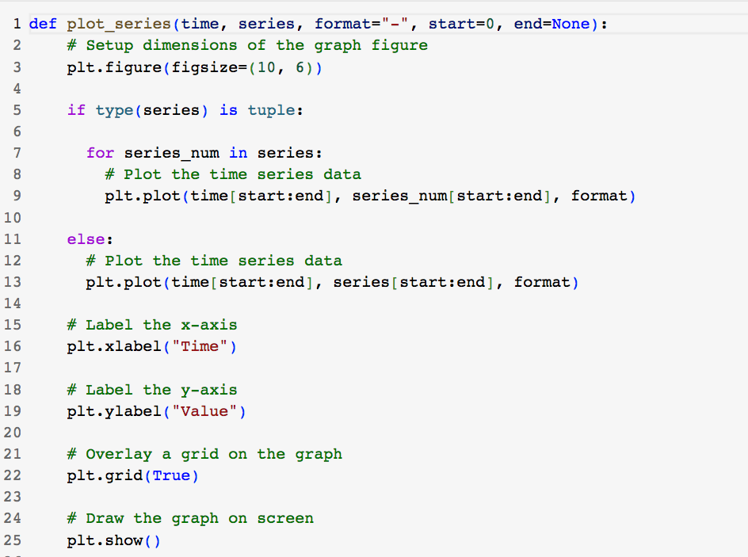
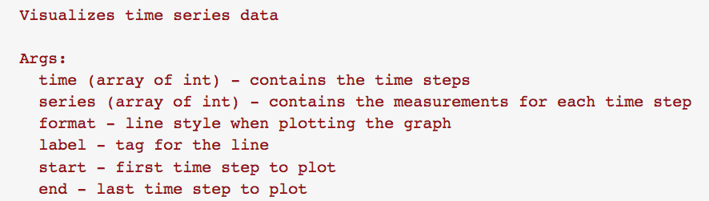
Training a Deep Neural Network
Utilities
Deep neural network training, tuning and prediction
‹#›
Notes:
‹#›

Slide 5
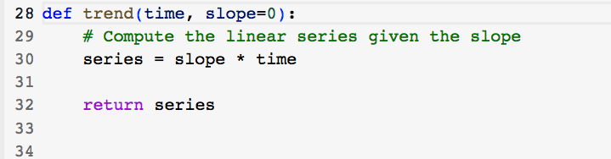
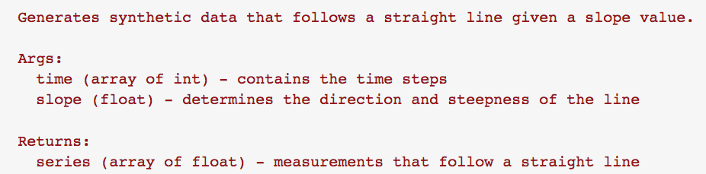
Training a Deep Neural Network
Utilities
Deep neural network training, tuning and prediction
‹#›
Notes:
‹#›

Slide 6
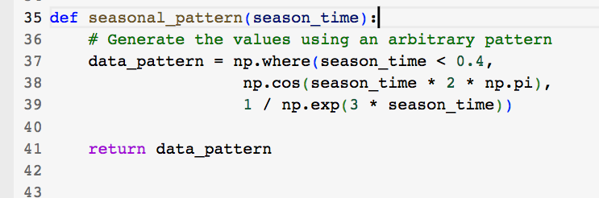
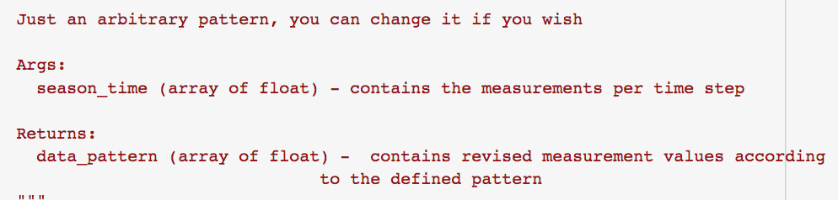
Training a Deep Neural Network
Utilities
Deep neural network training, tuning and prediction
‹#›
Notes:
‹#›

Slide 7
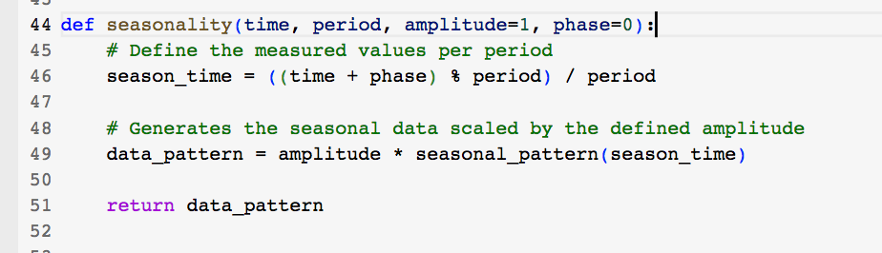
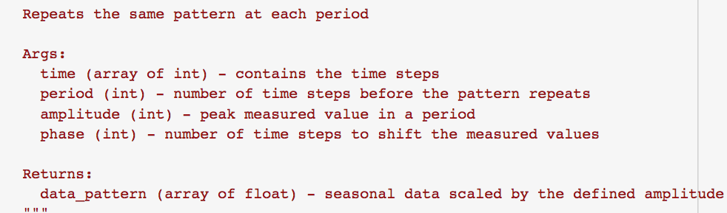
Training a Deep Neural Network
Utilities
Deep neural network training, tuning and prediction
‹#›
Notes:
‹#›

Slide 8
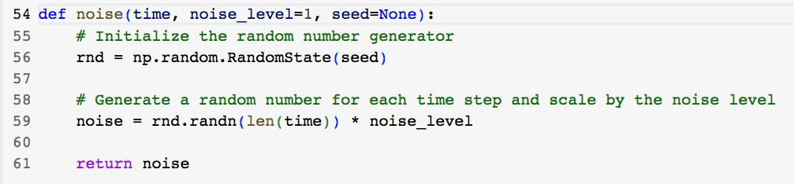
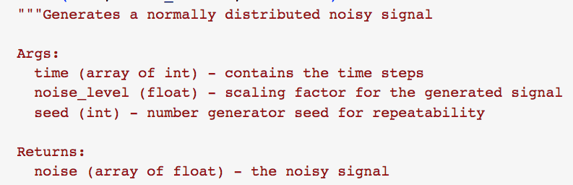
Training a Deep Neural Network
Utilities
Deep neural network training, tuning and prediction
‹#›
Notes:
‹#›

Slide 9
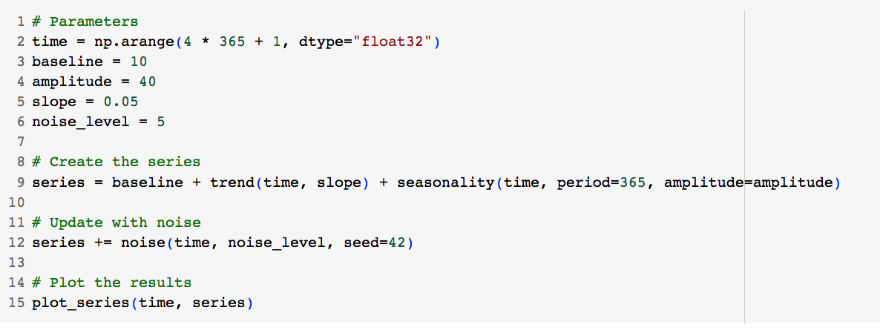
Training a Deep Neural Network
Generate the Synthetic Data
Deep neural network training, tuning and prediction
‹#›
Notes:
‹#›

Slide 10
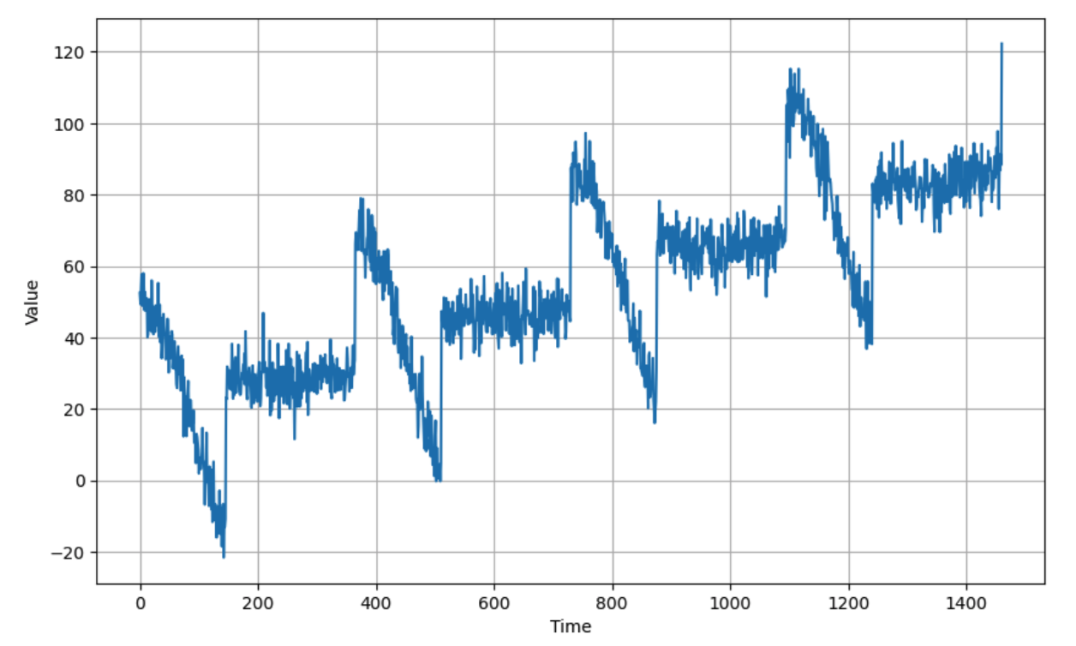
Training a Deep Neural Network
Generate the Synthetic Data
Deep neural network training, tuning and prediction
‹#›
Notes:
‹#›

Slide 11
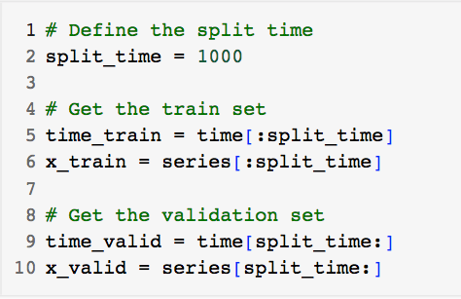
Training a Deep Neural Network
Split the Dataset
Deep neural network training, tuning and prediction
‹#›
Notes:
‹#›

Slide 12
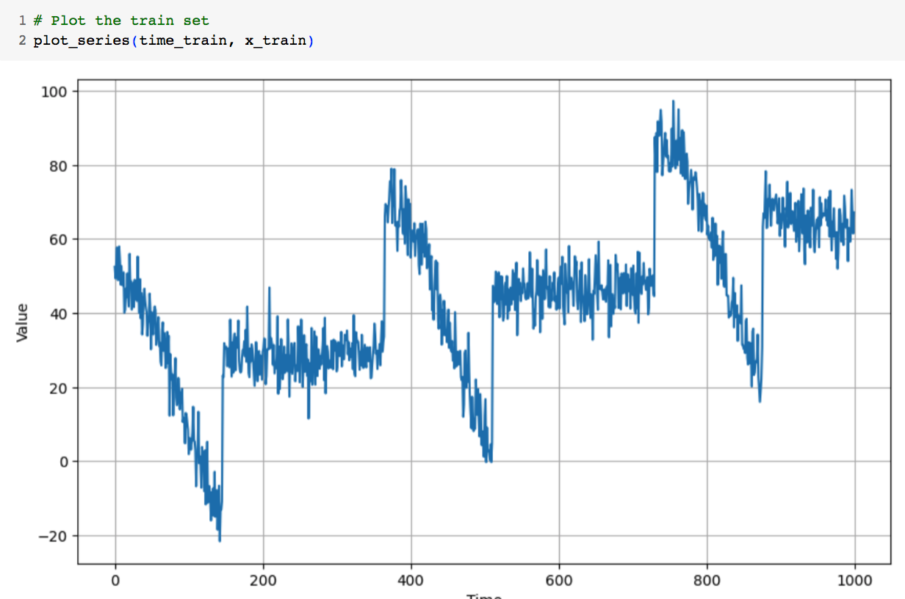
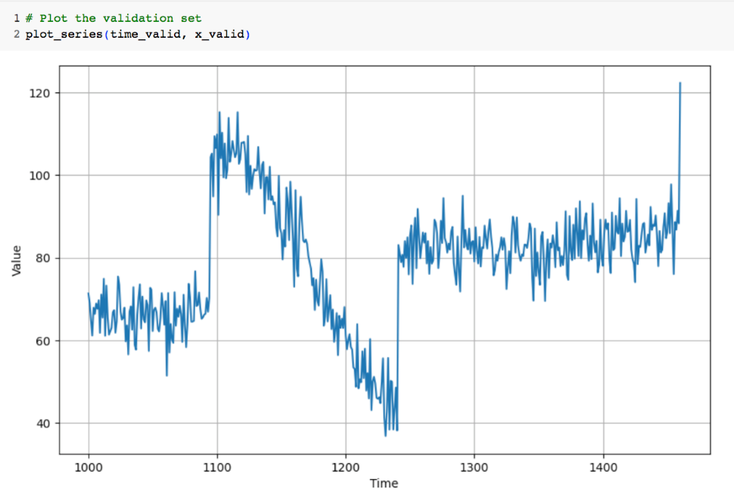
Training a Deep Neural Network
Train and validation set
Deep neural network training, tuning and prediction
‹#›
Notes:
‹#›

Slide 13
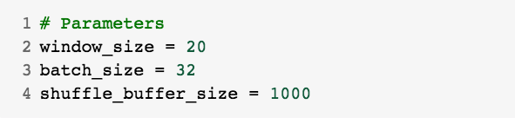
Training a Deep Neural Network
Prepare features and labels
Deep neural network training, tuning and prediction
‹#›
Notes:
‹#›

Slide 14
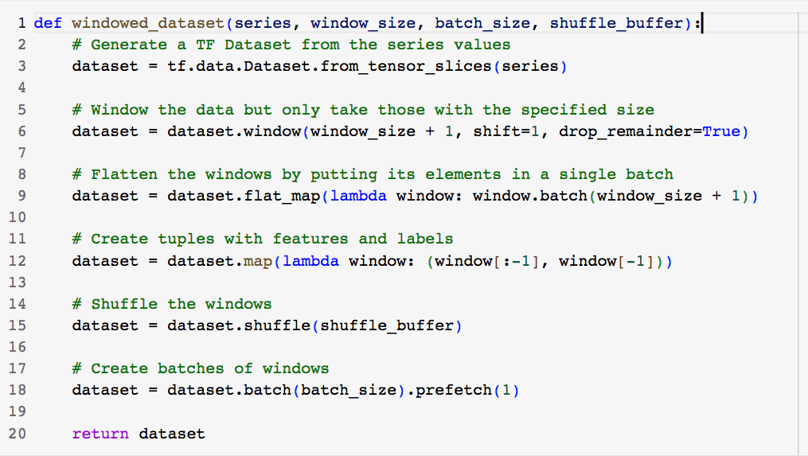
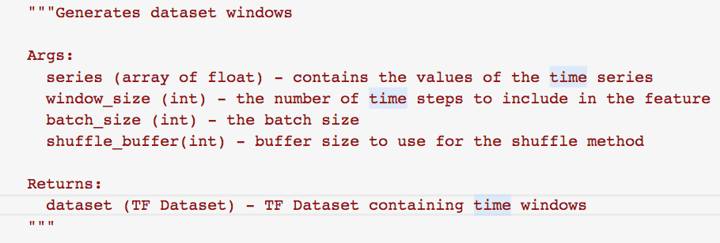
Training a Deep Neural Network
Generates dataset windows
Deep neural network training, tuning and prediction
‹#›
Notes:
‹#›

Slide 15
Training a Deep Neural Network
Generate the dataset windows from the train set.
Deep neural network training, tuning and prediction
‹#›
Notes:
‹#›

Slide 16
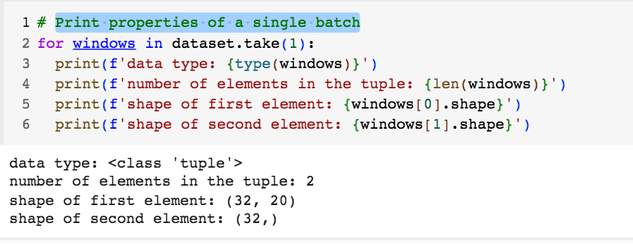
Training a Deep Neural Network
Print properties of a single batch
Deep neural network training, tuning and prediction
‹#›
Notes:
‹#›

Slide 17
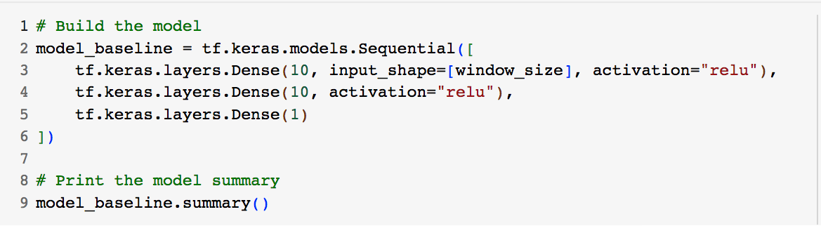
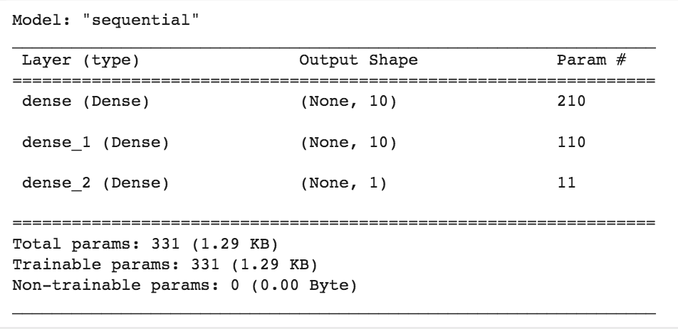
Training a Deep Neural Network
Build the Model
Deep neural network training, tuning and prediction
‹#›
Notes:
‹#›

Slide 18
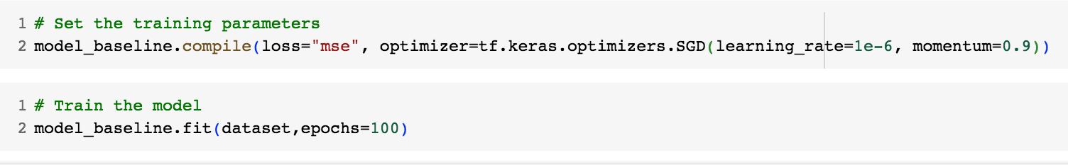
Training a Deep Neural Network
Train the Model
Deep neural network training, tuning and prediction
‹#›
Notes:
‹#›

Slide 19
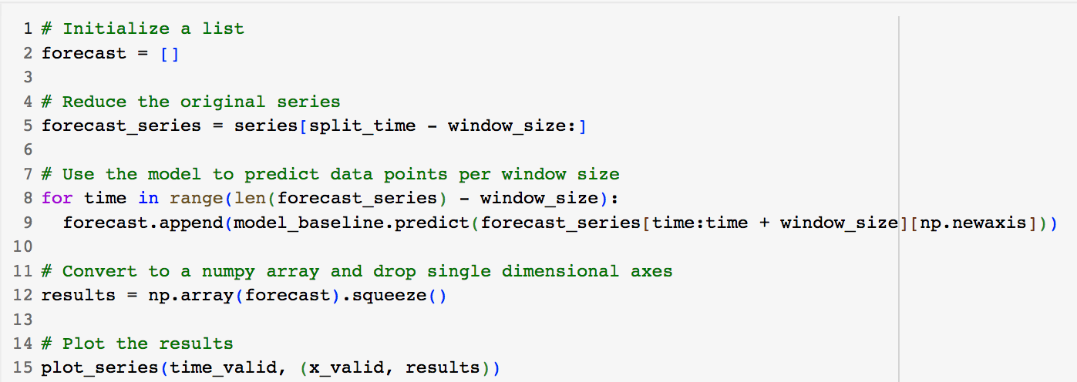
Training a Deep Neural Network
Results
Deep neural network training, tuning and prediction
‹#›
Notes:
‹#›

Slide 20
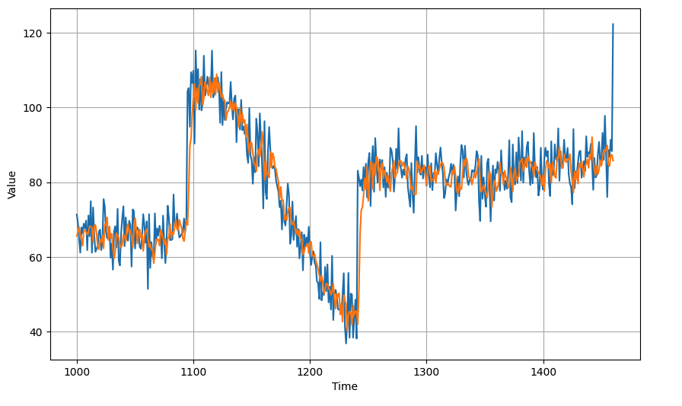
Training a Deep Neural Network
Result
Deep neural network training, tuning and prediction
‹#›
Notes:
‹#›

Slide 21
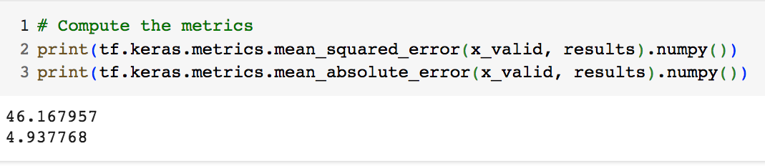
Training a Deep Neural Network
The MSE and MAE
Deep neural network training, tuning and prediction
‹#›
Notes:
‹#›

Slide 22
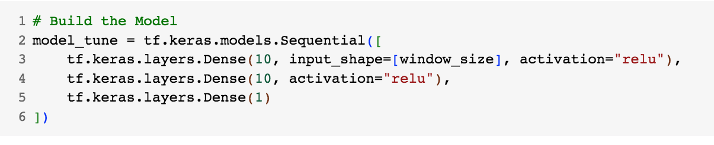
Training a Deep Neural Network
Apply tune the learning rate
Redefine the model
Deep neural network training, tuning and prediction
‹#›
Notes:
‹#›

Slide 23
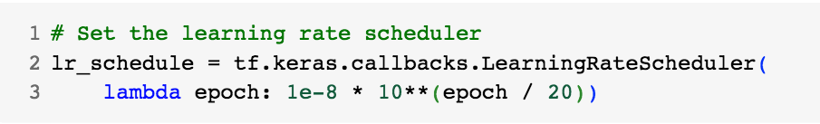
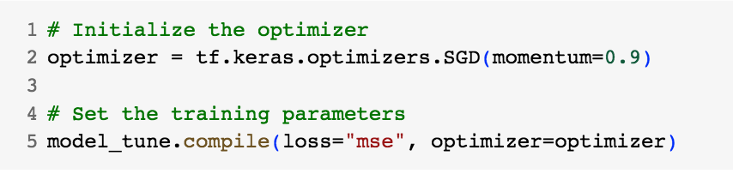
Training a Deep Neural Network
Declare a learning rate scheduler callback
Compile the model
Deep neural network training, tuning and prediction
‹#›
Notes:
‹#›

Slide 24
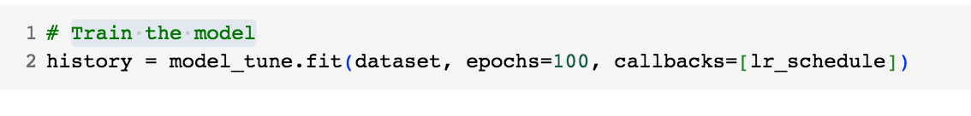
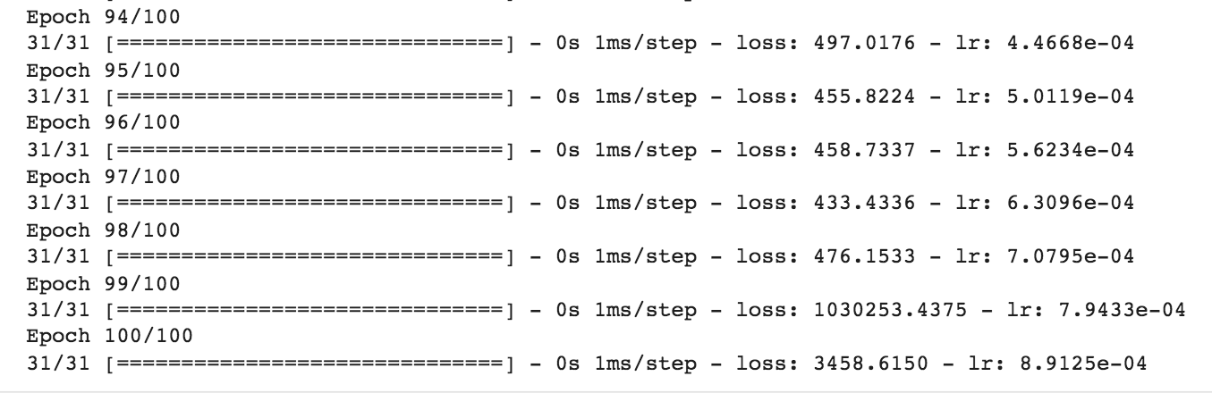
Training a Deep Neural Network
Train the model with callbacks
Deep neural network training, tuning and prediction
‹#›
Notes:
‹#›

Slide 25
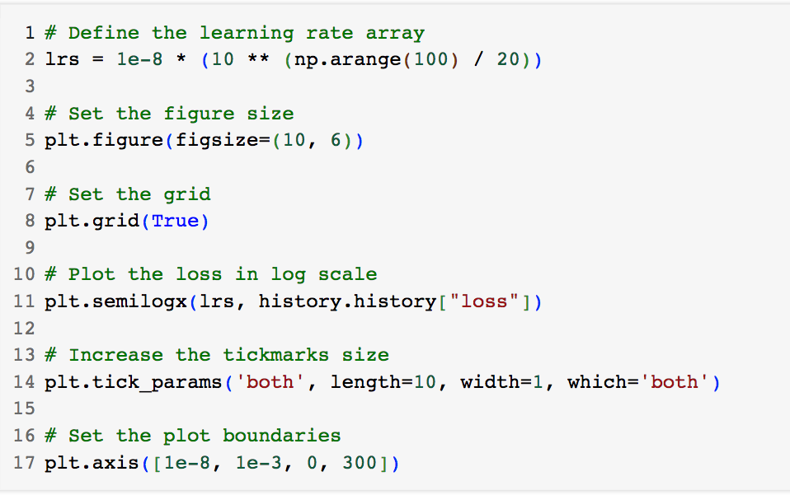
Training a Deep Neural Network
Plot the results of the training
Deep neural network training, tuning and prediction
‹#›
Notes:
‹#›

Slide 26
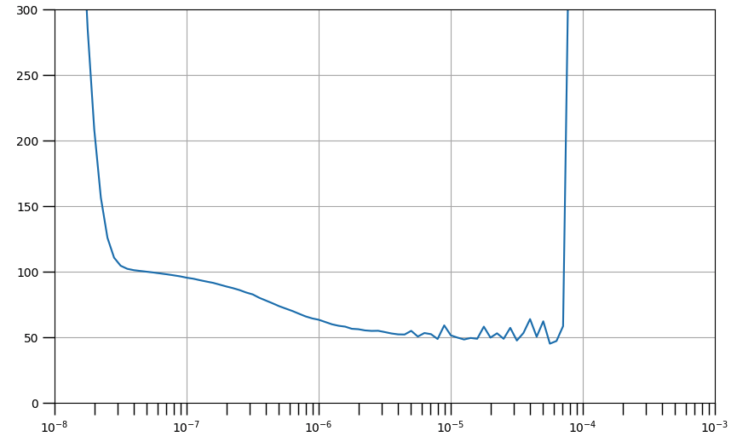
Training a Deep Neural Network
The values of the range of learning rates that leads to lower losses and also which ones cause the training to become unstable
Deep neural network training, tuning and prediction
‹#›
Notes:
‹#›

Slide 27
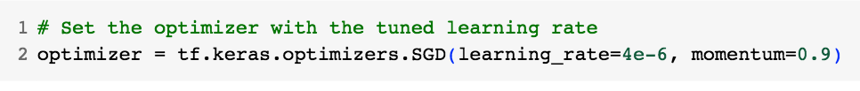
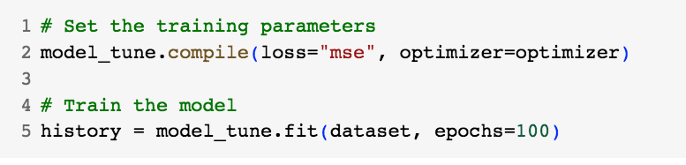
Training a Deep Neural Network
Redefine : set the optimizer with a learning rate close to the minimum
Compile and train the model
Deep neural network training, tuning and prediction
‹#›
Notes:
‹#›

Slide 28
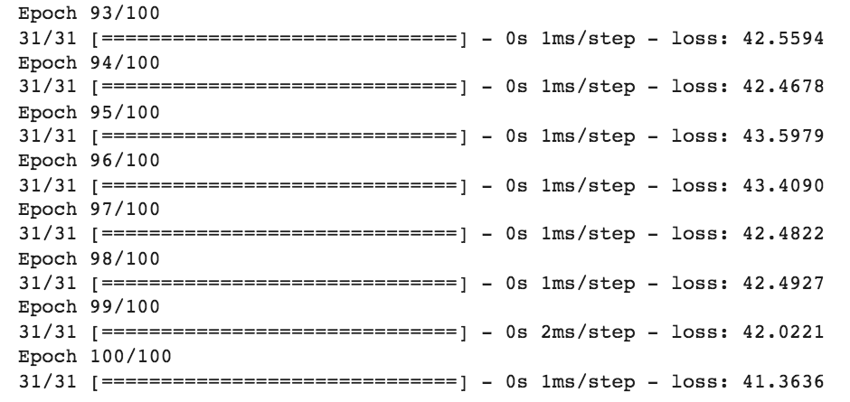
Training a Deep Neural Network
Training
Deep neural network training, tuning and prediction
‹#›
Notes:
‹#›

Slide 29
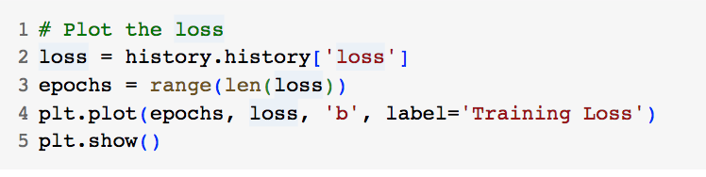
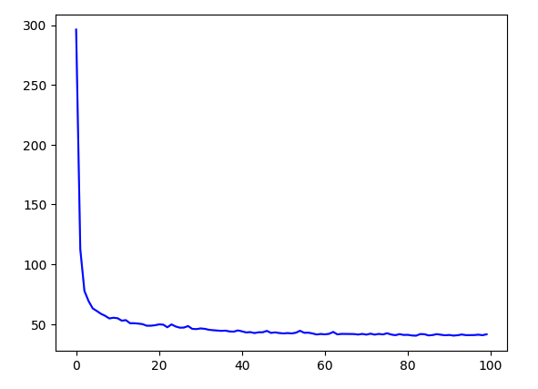
Training a Deep Neural Network
Plot the loss
Deep neural network training, tuning and prediction
‹#›
Notes:
‹#›

Slide 30
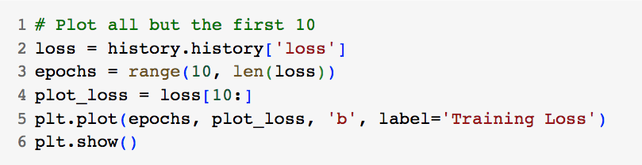
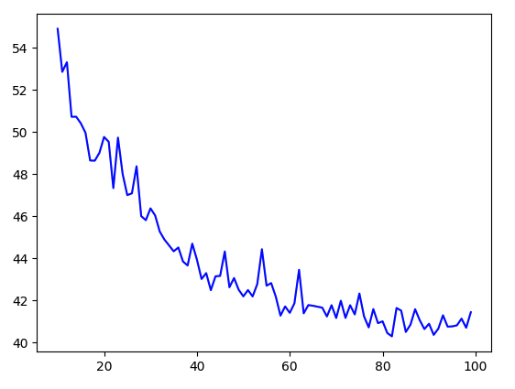
Training a Deep Neural Network
Plot all but the first 10
Deep neural network training, tuning and prediction
‹#›
Notes:
‹#›

Slide 31
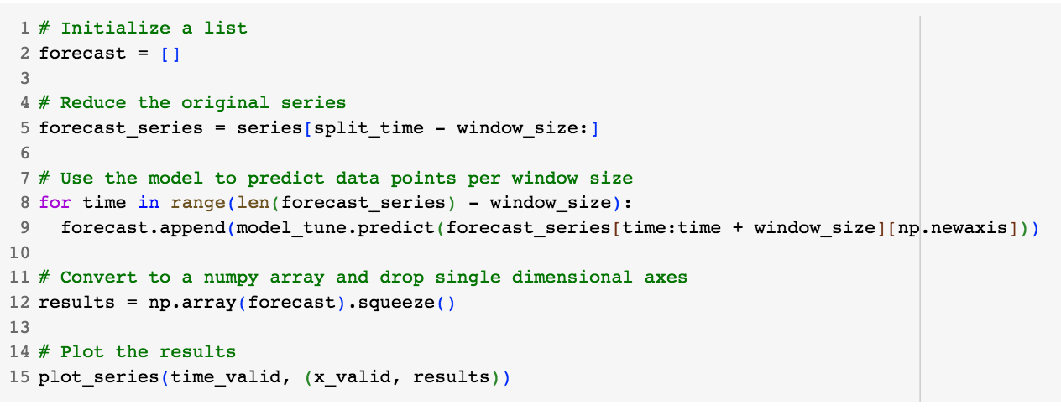
Training a Deep Neural Network
Get the predictions
Deep neural network training, tuning and prediction
‹#›
Notes:
‹#›

Slide 32
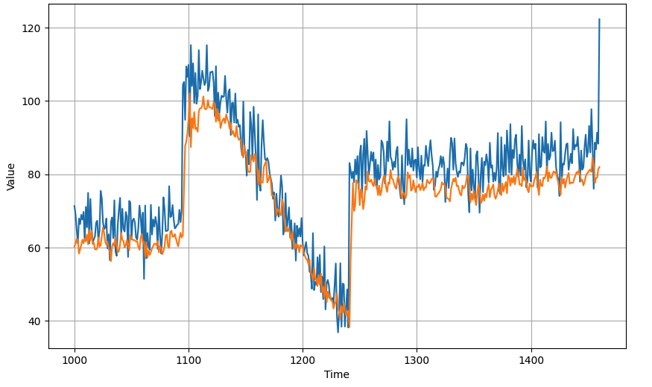
Training a Deep Neural Network
Get the predictions
Deep neural network training, tuning and prediction
‹#›
Notes:
‹#›

Slide 33
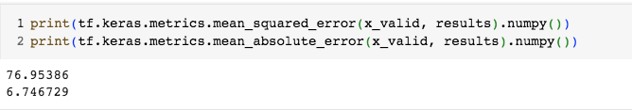
Training a Deep Neural Network
Compute the metrics
Deep neural network training, tuning and prediction
‹#›
Notes:
‹#›

Slide 34
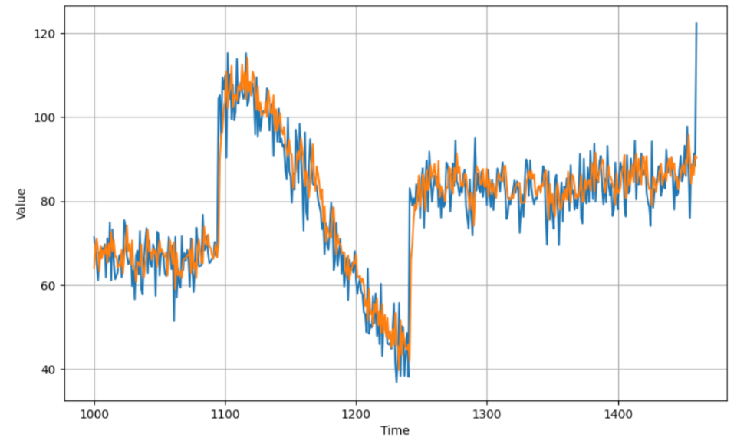
Training a Deep Neural Network
Student discuss and give opinions
Single layer
Multi layers
Deep neural network training, tuning and prediction
‹#›
Notes:
‹#›

Slide 35
Summary
Understand the training, tuning, prediction a Deep Neural Network with Time Series Data
Implement Deep Neural Network with more layers
Deep neural network training, tuning and prediction
‹#›

Slide 36
Q & A
Deep neural network training, tuning and prediction
‹#›

